Slide 2
Prediction of heart disease using classification
Mentor - Dr Tanupriya Chowdhury Prepared by - Rahul Jain Shweta Rawat Adarsh Mundra

Slide 3
An Introduction
Classification is a classic data mining technique based on machine learning. Basically, classification is used to classify each item in a set of data into one of a predefined set of classes or groups. Classification method makes use of mathematical techniques such as decision trees, KNN, neural network, and statistics.

Slide 4
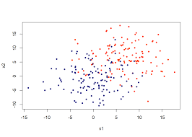
Classification is all about plotting the data points and finding out the line that best fits the data so that for a new input variable we can predict the output for that.

Slide 5
Problem Statement
The heart disease accounts to be the leading cause of death worldwide. It is difficult for medical practitioners to predict the heart attack as it is a complex task that requires experience and knowledge. The health sector today contains hidden information that can be important in making decisions. Data mining can solve the problem by discovering hidden patterns in large data sets according to different perspectives for categorization into useful information.

Slide 6
Motivation
We are in the era of Information age where terabytes of data are produced and stored everyday because of fast growth in “Information Technology”.
Huge amount of data is being generated by hospitals such as heart paining results, x-ray, chest pain results, blood pressure etc.

Slide 7
Motivation
The motivation of this project is to analyze the dataset to predict if a person has heart disease or not using one of the famous data mining technique KNN. The project includes all the necessary steps in data mining starting from Data cleaning, Data transformation and finally training the KNN model to make predictions.

Slide 8
Proposed method
Getting a good dataset is the completion of 70% of your work. The work starts from gathering a good dataset and loading it in our work space followed by data preprocessing. Below are the steps or modules to be followed in the work.
1. Load the Dataset
2. Data Preprocessing
Splitting the data into train and test sets
Build the Classifier
Prediction

Slide 9
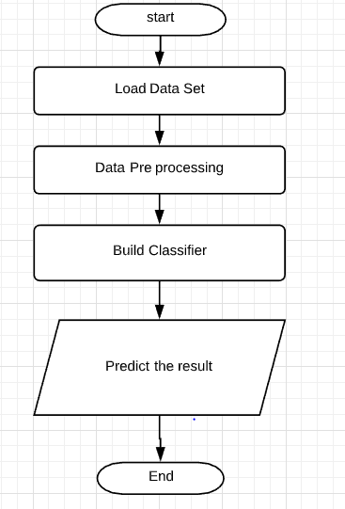
Design Phase
FLOW CHART DIAGRAM

Slide 10
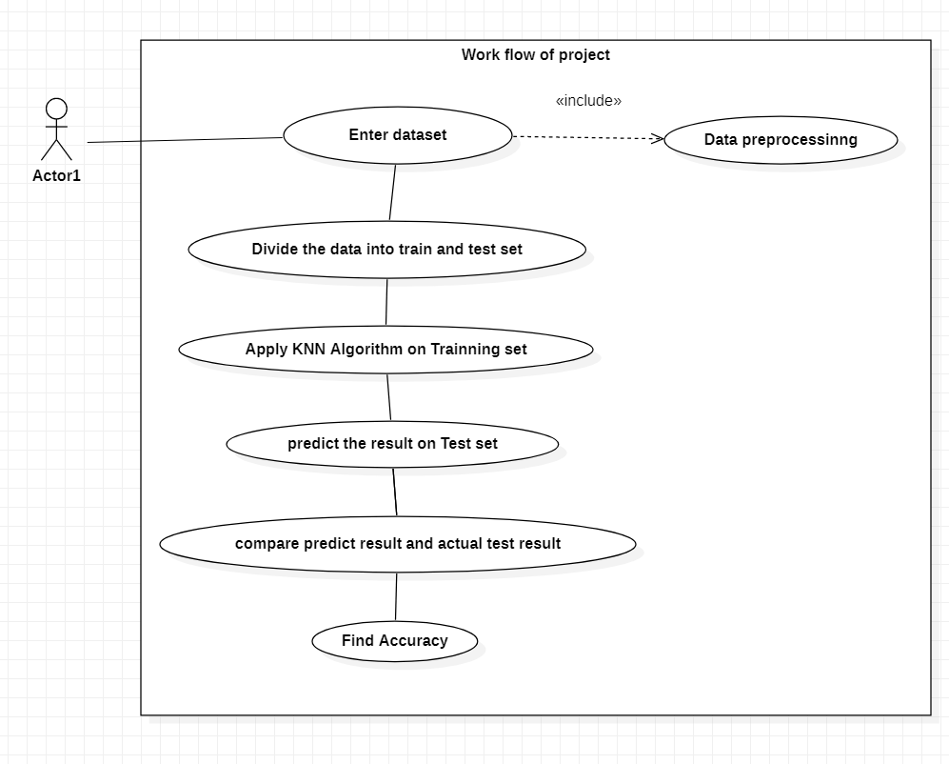
USE CASE DIAGRAM

Slide 11
K-Nearest Neighbors
KNN algorithm is one of the simplest classification algorithm and it is one of the most used learning algorithms. It is a lazy learning algorithm. Its purpose is to use a database in which the data points are separated into several classes to predict the classification of a new sample point.

Slide 12
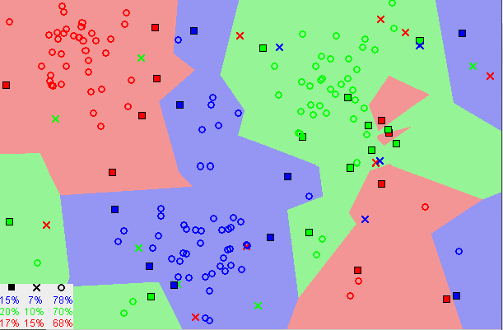
K-Nearest Neighbors
Example of KNN (image source: https://towardsdatascience.com/machine-learning-basics-with-the-k-nearest-neighbors-algorithm-6a6e71d01761)

Slide 13
Objective
Our objective being effectively using the important data that is generated from the hospitals to find patterns using a well known
Data mining algorithm known as KNN . Heart disease is no doubt has the largest proportions of deaths in the world and researchers are continuously working in this field to find a way out to solve this problem. We discovered some new methods to load the data sets,
pre process the data and build the classifier in C language and also
tried to minimize the time complexity of our code.

Slide 14
Objective
Our main objective is to predict the person has symptoms of heart attack or not.
Try to increase the accuracy of predicting a heart attack.
Now a day’s terabytes of data are produced in a day, So we use that data to analyze our result.

Slide 15
ALGORITHM
1. Load the data
2. Initialize K to your chosen number of neighbors
3. For each data sample
3.1 Calculate the distance between the new data point and every other data point in the data set.
3.2 Append the distance and the index of the new data point to a new array.
4. Sort the ordered collection of distances and indices from in ascending order of distance
5. Pick the first K values from the sorted collection.
6. Get the labels of the selected K values.
7. If regression, return the mean of the K labels
8. If classification, return the mode of the K labels

Slide 16
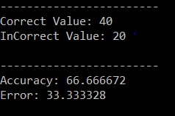
Output

Slide 17

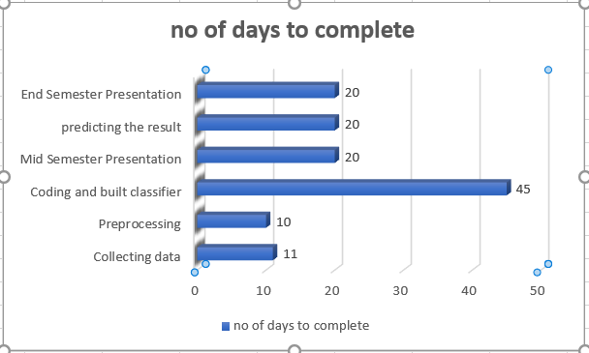
Plan of work (Gant Chart)

Slide 18
References
1. C. Ordonez, “Association rule discovery with the train and test approach for heart disease prediction,” IEEE transactions on Information technology in biomedicine: a publication of the IEEE Engineering in Medicine and Biology Society, vol. 10, no. 2,pp.334–43,Apr.2006.
2. K losgen W and Zytkow J M (eds.), Handbook of data mining and knowledge discovery, OUP, Oxford, 2002
3. Vikas Chaurasia, and Saurabh Pal, Data Mining Approach to Detect Heart Dieses, International Journal of Advanced Computer Science and Information Technology, Vol. 2, No. 4, pp. 56- 66, 2013.

